Slide 1

NAME : S.VENNELA ROLLNO : 22VE1A05R0 SUBJECT : JAVA TOPIC : SWING CONTROLS – JLABEL , ICONS

Slide 2
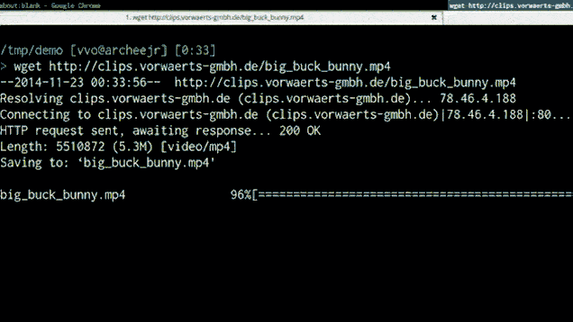


Slide 3
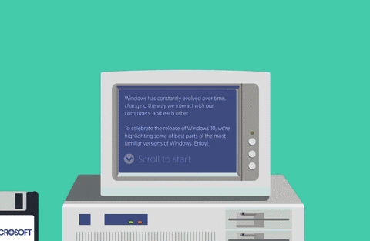

Slide 4
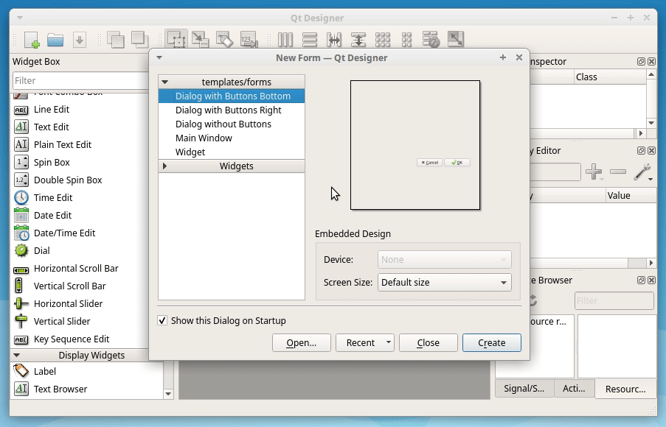

Slide 5
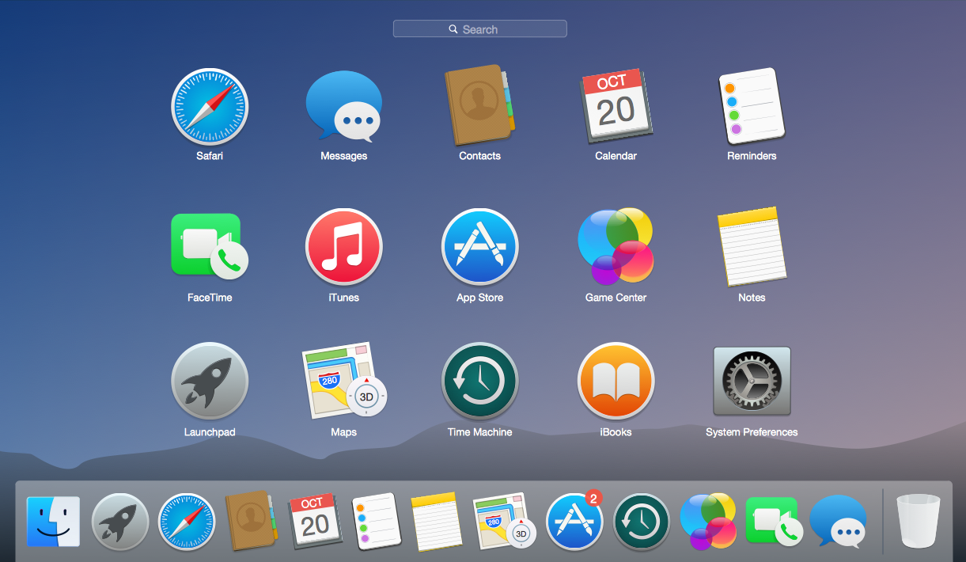

Slide 6
GRAPHICAL USER INTERFACE
A system of interactive visual components for a computer or system software is called a GUI (graphical user interface). GUI is the interface that uses graphical elements to let people interact as per requirement with electronic devices including computers, laptops, tablets, and smartphones. In terms of human-computer interaction systems or technology, it’s a very important component of software application programming since it substitutes actions for the text-based commands in the system.

Slide 7

CAN WE MAKE SUCH GUI’S IN JAVA ?
The Answer is Yes depending on requirements of our Application ,target Platform ,Preferences.
JavaFX
SWINGS
AWT
Java WebdevOp
(Servlets,JSP)
Libraries and Frameworks
(SWT,Vaadin)
Java Applets

Slide 8
Swing is a GUI widget toolkit for Java.^{[1]} It is part of Oracle's Java Foundation Classes (JFC) – an API for providing a graphical user interface (GUI) for Java programs. Swing was developed to provide a more sophisticated set of GUI components than the earlier Abstract Window Toolkit (AWT).
WHAT ARE SWINGS ?

Slide 9
WHAT ARE THE SPECIALITIES OF SWINGS ?
Swing is a Set of API (API- Set of Classes and Interfaces)
Swing is Provided to Design Graphical User Interfaces
Swing is an Extension library to the AWT (Abstract Window Toolkit)
Includes New and improved Components that have been enhancing the looks and Functionality of GUIs’
Swing can be used to build (Develop) The Standalone swing GUI Apps as Servlets and Applets
It Employs model/view design architecture.
Swing is more portable and more flexible than AWT, the Swing is built on top of the AWT.
Swing is Entirely written in Java.
Java Swing Components are Platform-independent, and The Swing Components are lightweight.
Swing Supports a Pluggable look and feel and Swing provides more powerful components.
such as tables, lists, Scrollpanes, Colourchooser, tabbed pane, etc.
Further Swing Follows MVC.

Slide 10
LET’S WRITE A JAVA PROGRAM USING SWINGS:
import javax.swing.*;
import java.awt.*;
import java.awt.event.*;
public class IconSelector extends JFrame implements ActionListener {
private JLabel iconLabel;
public IconSelector() {
super("Icon Selector");
setDefaultCloseOperation(JFrame.EXIT_ON_CLOSE);
setSize(300, 200);
// Create a panel to hold the buttons
JPanel buttonPanel = new JPanel(new GridLayout(1, 3));
}

Slide 11
// Create buttons for selecting icons
JButton icon1Button = new JButton("Icon 1");
JButton icon2Button = new JButton("Icon 2");
JButton icon3Button = new JButton("Icon 3");
// Add action listeners to the buttons
icon1Button.addActionListener(this);
icon2Button.addActionListener(this);
icon3Button.addActionListener(this);
// Add buttons to the panel
buttonPanel.add(icon1Button);
buttonPanel.add(icon2Button);
buttonPanel.add(icon3Button);

Slide 12
// Create a label for displaying icons
iconLabel = new Jlabel();
iconLabel.setHorizontalAlignment(JLabel.CENTER);
// Add components to the frame
add(buttonPanel, BorderLayout.NORTH);
add(iconLabel, BorderLayout.CENTER);
}
// Action performed when a button is clicked
public void actionPerformed(ActionEvent e) {
String command = e.getActionCommand();
ImageIcon icon = null;

Slide 13
// Load the appropriate icon based on the button clicked
switch (command) {
case "Icon 1":
icon = newImageIcon("C:\\Users\\MAHENDER\\OneDrive\\Documents\\img10.jpg");
break;
case "Icon 2":
icon = newImageIcon("C:\\Users\\MAHENDER\\OneDrive\\Documents\\img5.jpg");
break;
case "Icon 3":
icon = new ImageIcon("C:\\Users\\MAHENDER\\OneDrive\\Documents\\img8.jpg");
break;
}
// Set the icon to the label
iconLabel.setIcon(icon);
}

Slide 14
public static void main(String[] args) {
SwingUtilities.invokeLater(new
Runnable() {
public void run() {
IconSelector iconSelector = new IconSelector();
iconSelector.setVisible(true);
}
});
}
}

Slide 15
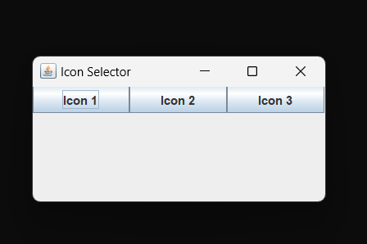
OUTPUT :-

Slide 16
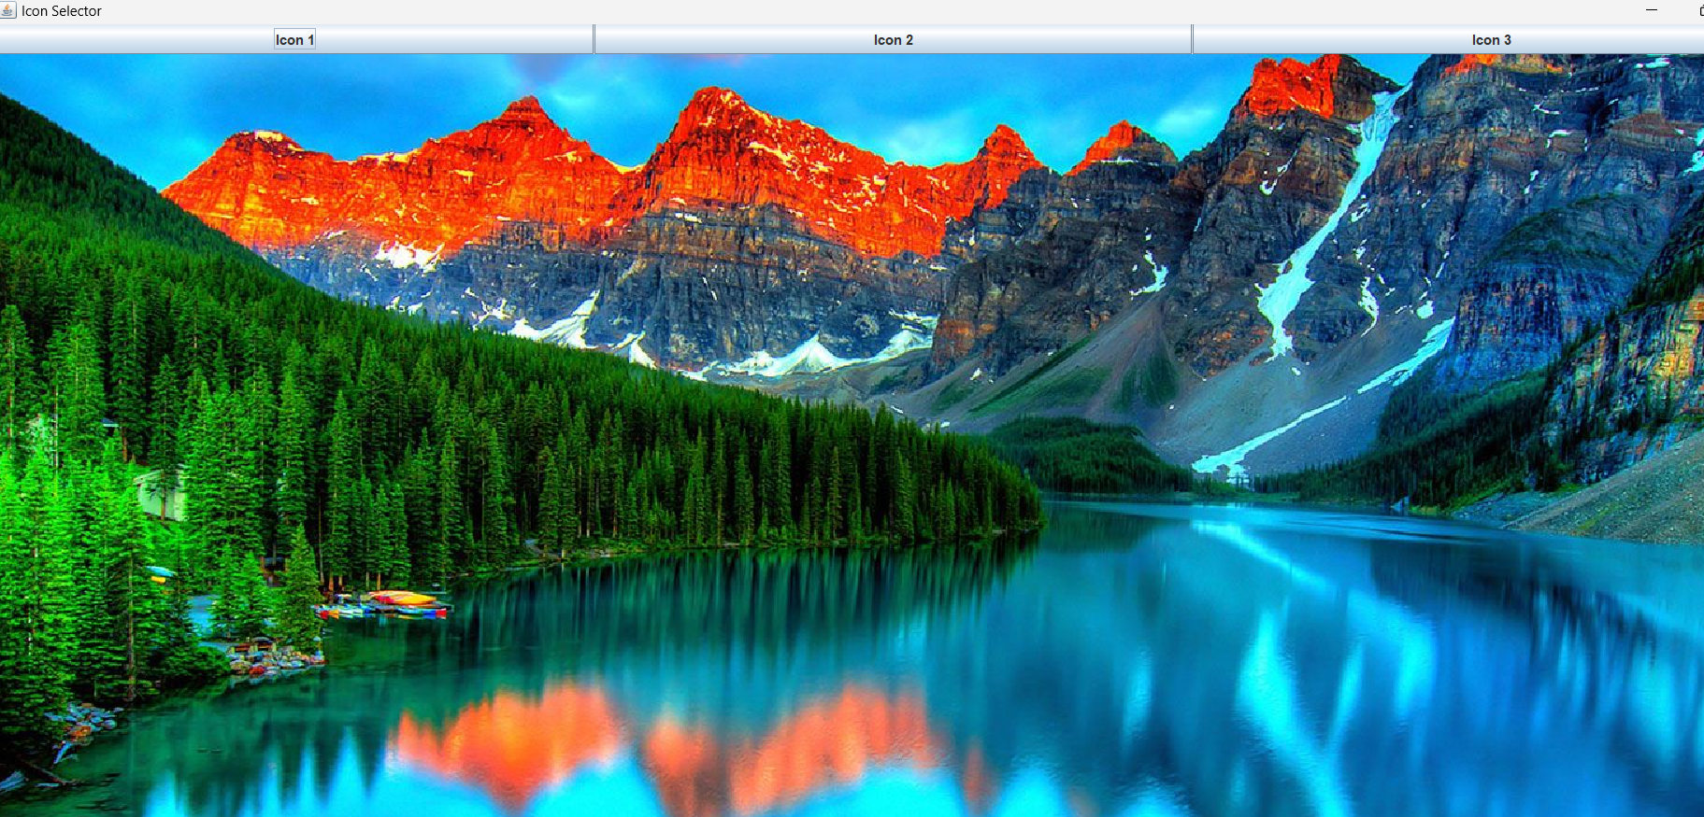

Slide 17
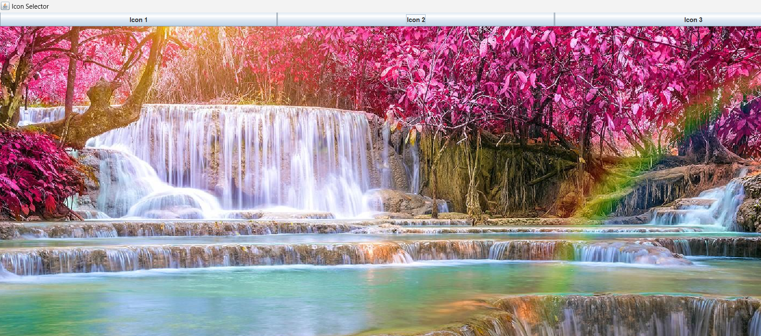

Slide 18
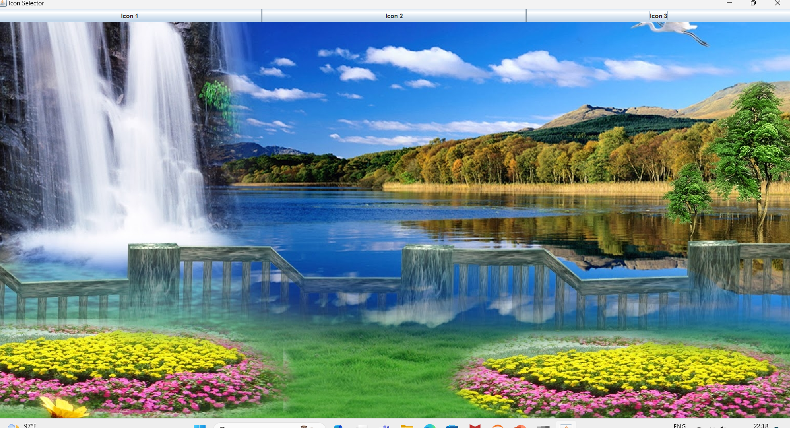

Slide 19


